Slide 1
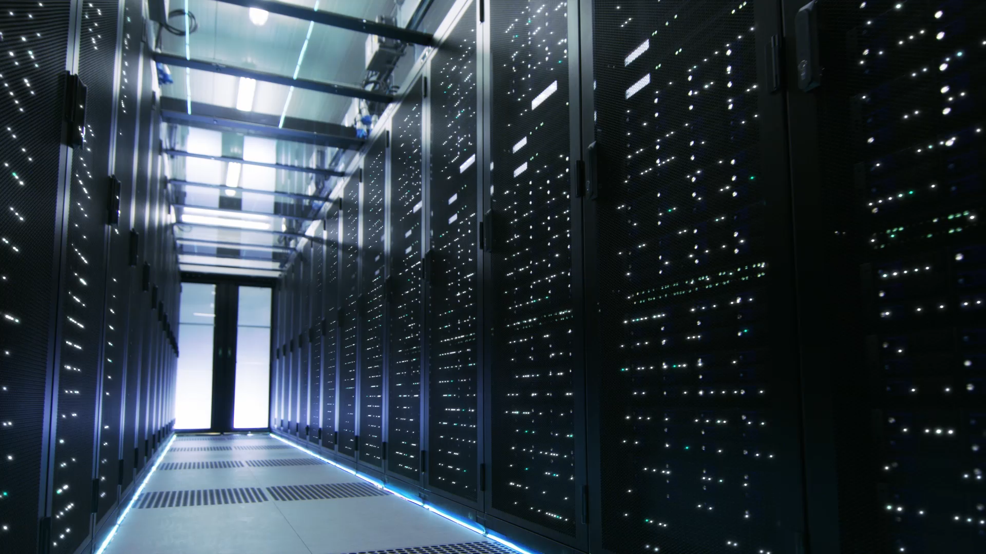
StAT995: Batch Machine Learning
Minnie Tan
Oct 8, 2021

Slide 2
Background
Stunning Data Facts:
In 2020, people created 1.7 MB of data every second.
At the end of 2020, 44 zettabytes in the entire digital universe.
By 2025, 200+ zettabytes of data will be in cloud storage around the globe, having 75 billion Internet-of-Things (IoT) devices in the world
463 exabytes of data will be generated each day by people as of 2025.
By 2030, nine out of every ten people aged six and above would be digitally active.
Sources:
How Much Data Is Created Every Day in 2021? [You'll be shocked!] (techjury.net)
How Much Data Is Created Every Day? [27 Powerful Stats] (seedscientific.com)

Slide 3
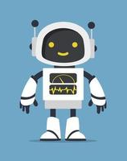
Batch Machine Learning
To minimize user interaction or development
To have saveable retrievable results archived by date, time
To have the statistical metrics in selection of different modelling techniques used

Slide 4
Software Use
Input Files
config.json
Processing
Pre-processing
Output Files
Excel Files (Global, As Per Model)
input.txt
Modelling Techniques
Graphic Files

Slide 5
Input Files

Slide 6
Tool Execution
python –W ignore main.py –i input_classifier.txt

Slide 7
Output Files

Slide 8
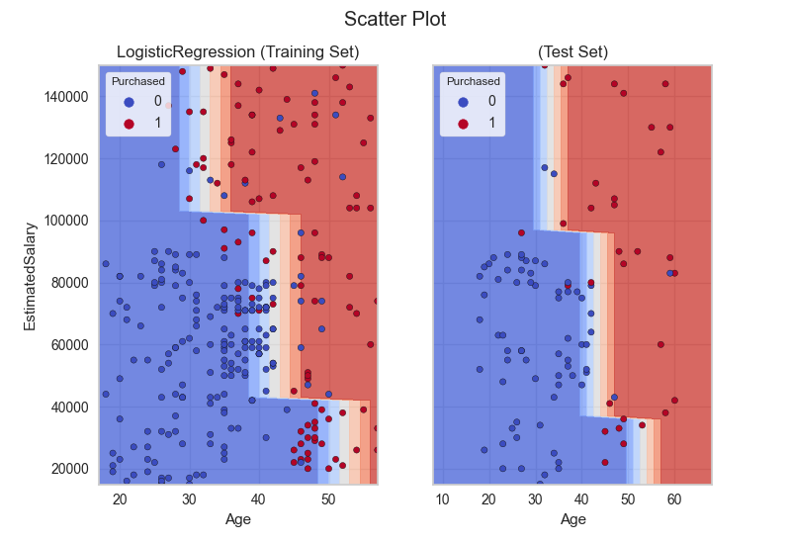
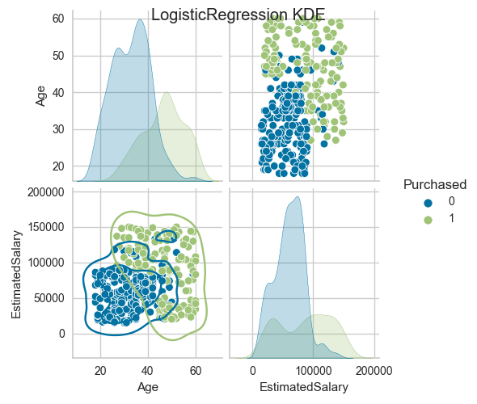
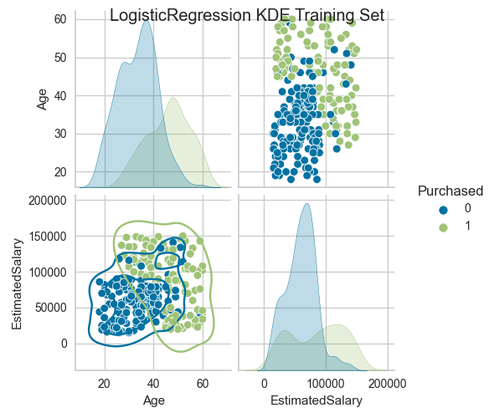
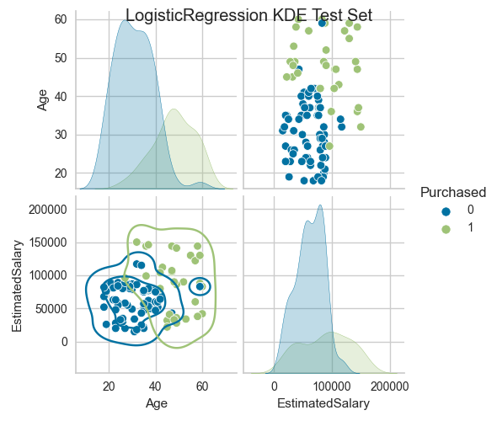
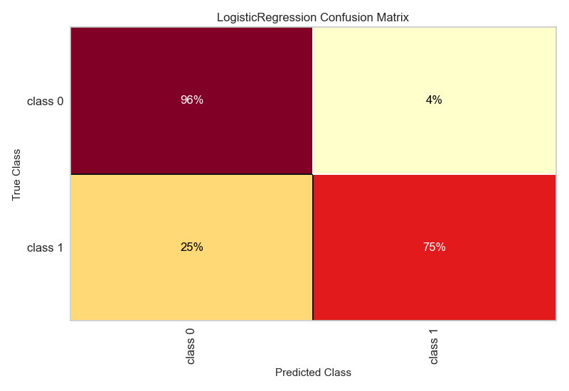
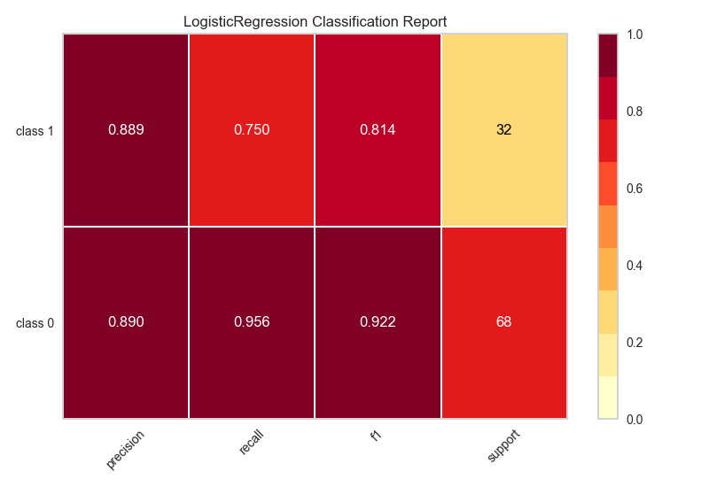
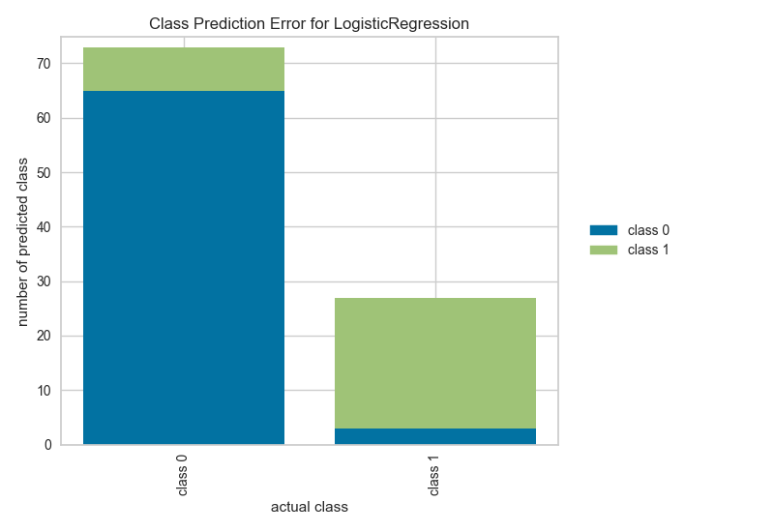
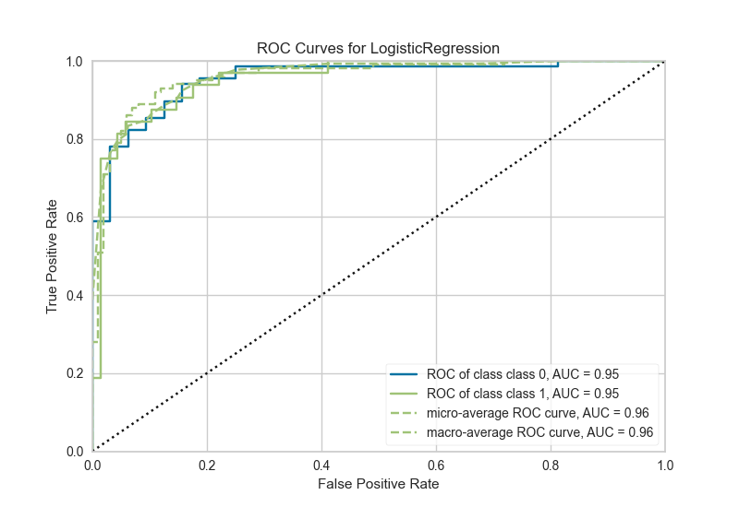
Output Files

Slide 9
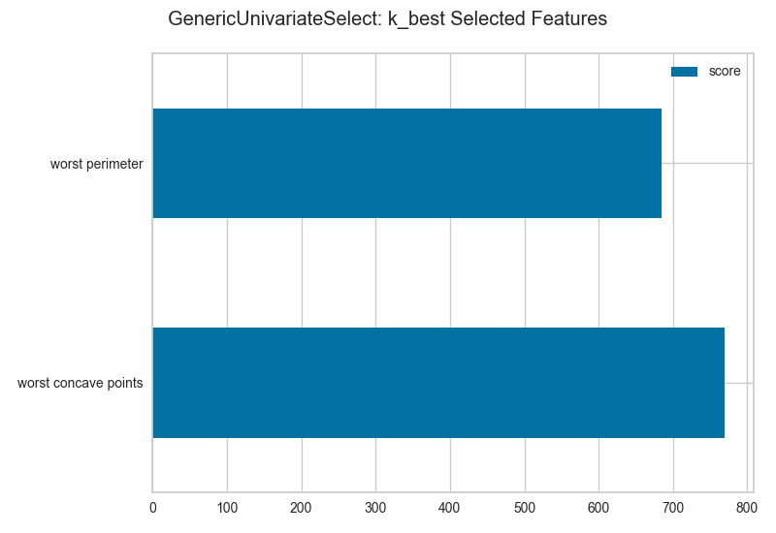
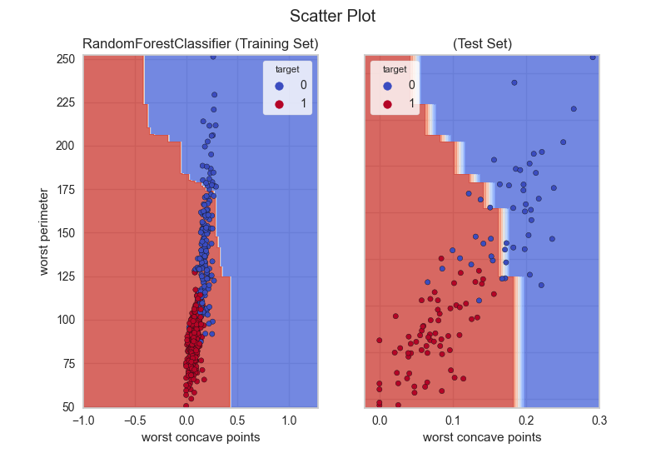
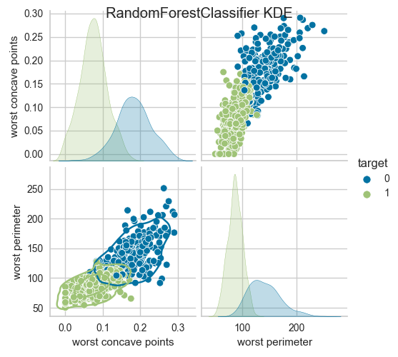
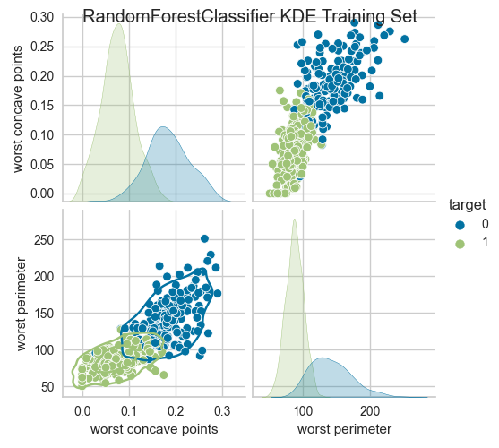
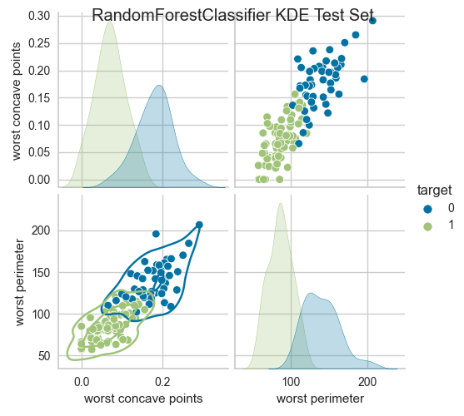
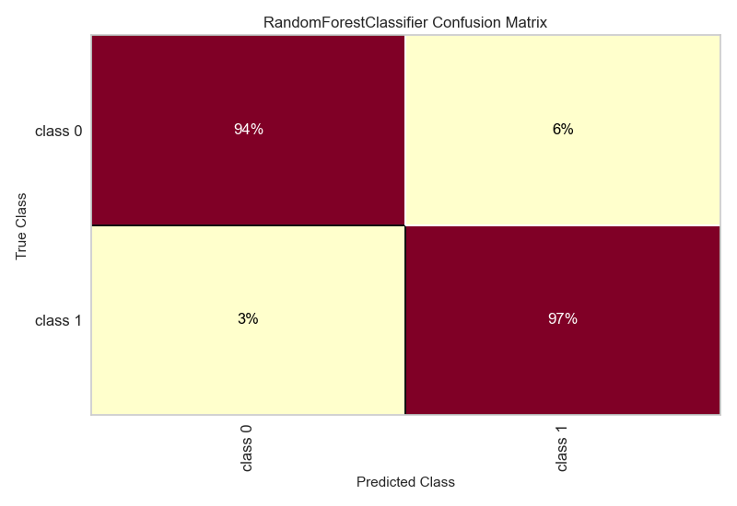
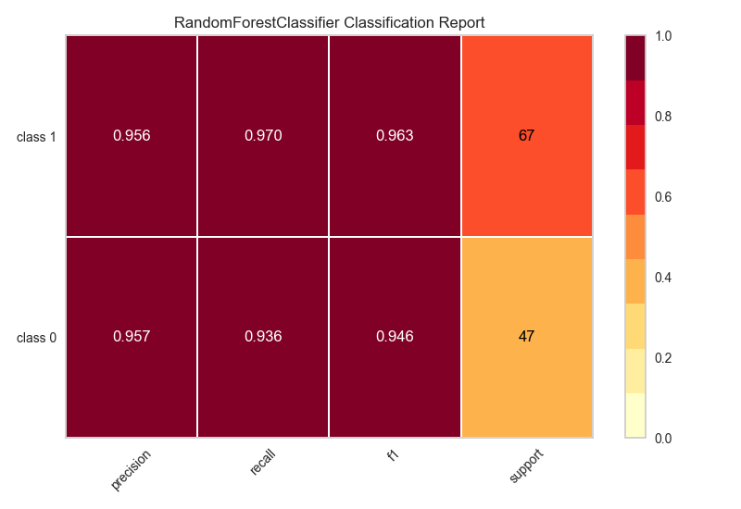
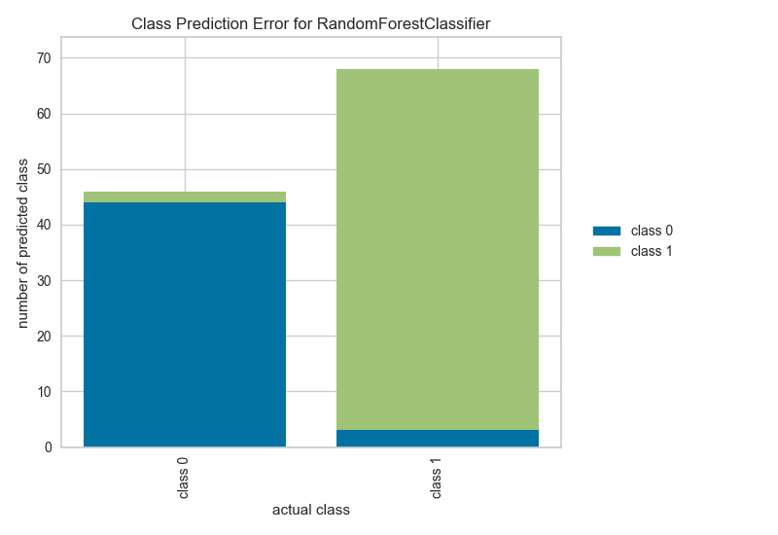
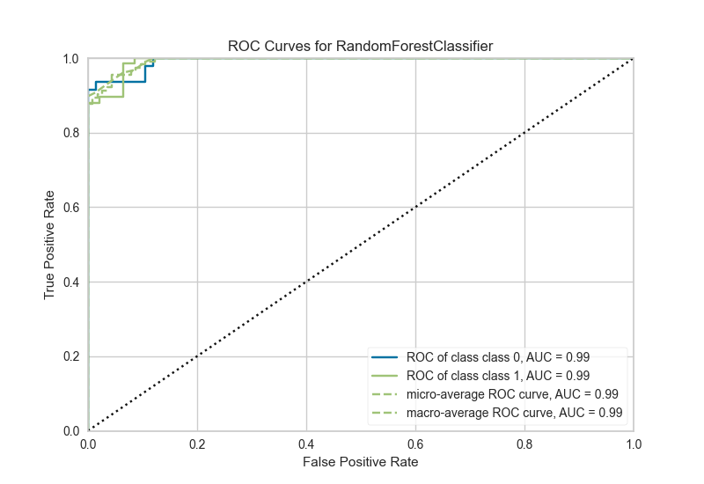
Input /Output Files (For Other Example)

Slide 10
Progress / Upcoming Tasks (as Part-time)
Week | Progress
Week 1 | - Prior weeks base version is created: main.py, model.py, preprocessor.py
Week 2 | Proposal documentation, updated to have the dynamic parser with different implementations, debugging
Week 4-7 | Add/Update document, updated the preprocessor, debugging. With the update of the input files, other files like constant.py, helper.py
Week 7-10 | Add/Update document, updated model interface to have metrices, added regressor/ classification, tested for several classifications
Week 11-12 | Add/Update document, added cluster: KMeans, Agglomerative, added ppt for project progress
Week 13-16 | Add/Update document, for some clustering, rules
Week 17-22 | Add/Update document, for some neural network (lstm or time series)

Slide 11
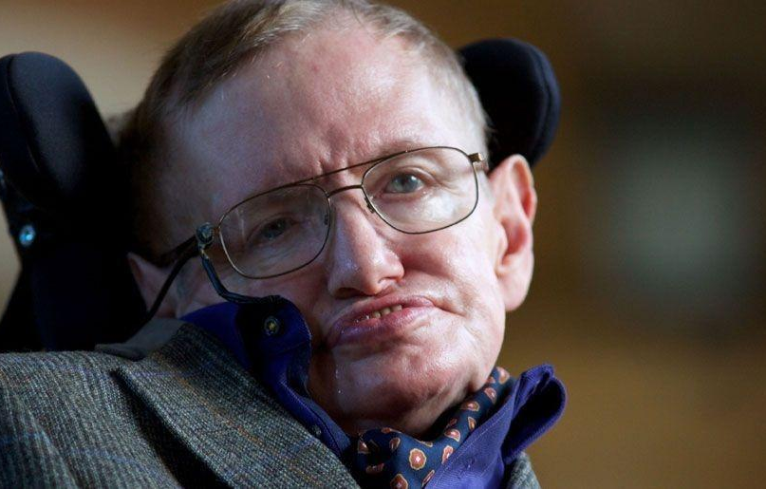
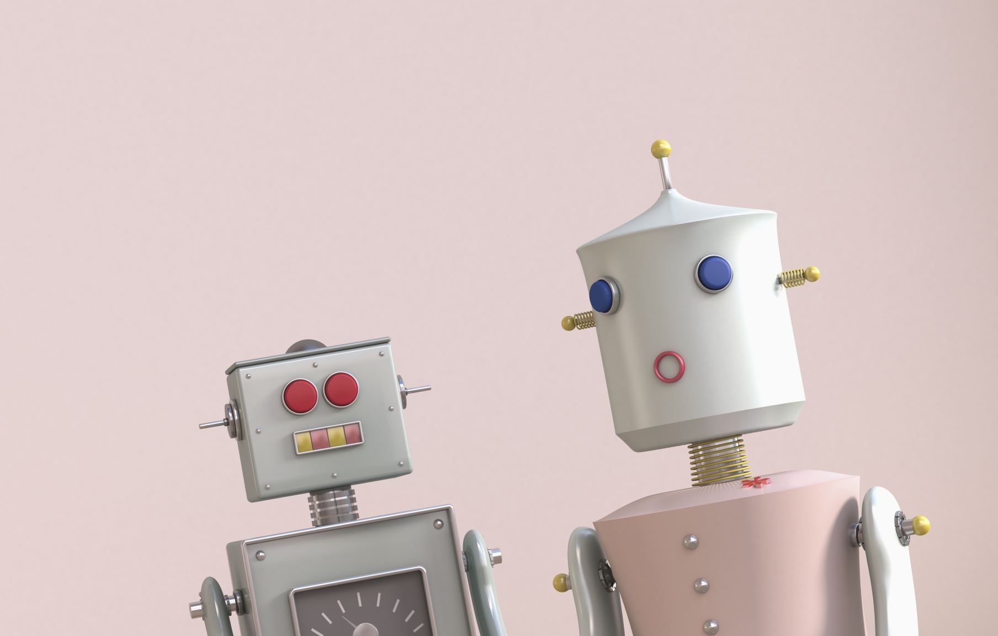
Stephen Hawking
Robots will replace humans completely.
Sources:
Stephen Hawking: Robots will replace humans completely (aol.com)

